Slide 1
Interviews: Types, Focus, and Objectives

Slide 2
Meaning of Interview
An interview is a structured conversation where one person (the interviewer) asks questions and the other (the interviewee) responds. It aims to gather information, assess suitability, or share perspectives.
An interview is usually a formal meeting, it provides an opportunity to the participants to exchange views and also to evaluate others.
An interview is a structured conversation between an interviewer and an interviewee, most commonly used to assess a candidate's suitability for a job or position. Preparation is crucial, and it involves researching the company, understanding the job description, and practicing common questions. During the interview, focus on listening carefully, presenting your skills and experiences confidently, and being professional.

Slide 3
Objectives of an Interview
• To Evaluate – Assess knowledge, skills, personality, and attitude.
• To Select – Choose the right person for a role or purpose.
• To Inform – Provide information about the organization or issue.
• To Clarify – Gain deeper understanding or verify facts.
• To Persuade – Influence or motivate others.
• To Establish Relationship – Build rapport and professional connection.

Slide 4
Focus of an Interview
• Purpose-driven – Depends on interview goal (job, research, media).
• Information-oriented – Gather accurate and relevant data.
• Behavioral & Attitudinal – Understand motivation and communication style.
• Decision-making – Support recruitment, admission, or evaluation.

Slide 5
Types of Interviews – Based on Structure
• Structured – Fixed questions for all candidates; ensures fairness.
• Unstructured – Open-ended, flexible, conversational.
• Semi-structured – Combination of fixed and open questions.

Slide 6
Types of Interviews – Based on Purpose
• Employment – For hiring or promotion decisions.
• Academic – For admission or research selection.
• Research – To collect qualitative data and opinions.
• Journalistic – For media or public interviews.
• Exit – Conducted when an employee leaves an organization.
• Counseling – For understanding and solving issues.

Slide 7
Types of Interviews – Based on Mode
• Face-to-Face – Direct personal interaction.
• Telephonic – Conducted over the phone.
• Video/Online – Conducted via digital platforms.
• Panel – Multiple interviewers assess one candidate.
• Group – Several candidates interviewed together.

Slide 8
Sequence of interviews
Before we discuss the types of interviews it is necessary to understand the typical sequence of interviews. Different organization interview potential candidates in different ways. Below are listed the three-tier process to interview.
The sequence is:
Screening stage
Selecting stage
Final stage

Slide 9
Screening stage
First is the preliminary stages known as the screening stage generally held at the campus.At this stage the employers 'motive is to screen out the unqualified and undeserving candidates.The employers try to judge if the applicant will be able to meet the requirement of the organization.
some of the organization nowadays interview the candidate for screening by phone or videoconferencing.

Slide 10
Selection Stage
At the second stage of interview the applicant will be asked to interact with several people: some from the human resource department, some potential colleagues and some supervisors. The interviewer at this stage of selection want to judge the applicant's interest in the job. He is seeking for his ability and his organizational capacity. The interviewee, during the selections days is advised to be alert and attentive.

Slide 11
Final Stage
Some organization conduct interview for final evolution where the candidate has to face some high ranking officers. These high-ranking executives ask certain questions and finally decides whether the applicant may receive a job offer.
“An underlying objective of the final stage is often to sell you on the advantages of joining the organization"

Slide 12
Types of Interview
Organizations use various types of interviews to discover as much as possible about the potential of the applicant. There can be various is type of interviews a candidate may face.
Structured interview
open ended interview
stress interview
group interview
panel interview
situational Interview
Video Interview

Slide 13
Structured Interview
A structured interview is generally used in the screening stage, in this the interviewer ask a series of prepared questions in a set order. The interviewer asks each candidate such already prepared questions with in an allotted time period, all the answer are noted down. The purpose of structured interviews is to screen out the candidate so that they can be passed on to the next stage

Slide 14
Open Ended Interview
Open Ended interview are usually used in the selection. It is less formal and also an structured with a relaxed formal. The interview poses open ended questions and wants the applicant to answer them freely.

Slide 15
Stress Interview
Stress interview are setup to judge the interviewee's capacity to handle the stressful situations. There are certain jobs for which it is an important qualification. The purpose of such interviews is to disqualify those who were not able to handle a stressful situation.

Slide 16
Group Interview
Generally the individual interview are set up to interview the applicant. But now a days group interviews have also been in practice in which candidates of a group are interviewed at the same time by the panel of interviewers. The recruiters see how candidate interact with one another. This type of interview is useful for judging the interpersonal skills of the person

Slide 17
Panel Interview
some companies setup panel interview in which an applicant is interviewed by several interviewers. Each interviewer asks questions. Applicant has to keep his composure and be able to answer the questions of the panel of interviewers .

Slide 18
Situational Interview
Another modern twist is the situational interview in which the interviewer describes the situation and ask, "how would you handle this?.”
The purpose of situational interview is to find out how well the applicant performs on the job because in traditional interview the candidates can answer well but they do not perform well when they are put to work in a specific situation.

Slide 19
Video Interview
video interviews are becoming very popular. Some large organizations use video conferencing systems to screen out potential candidates. Video interviews require some special preparation such as clarity of speech, an acquaintance with the equipments and setting and some techniques of nonverbal communication.

Slide 20
Before the interview
Research the company: Understand its mission, values, and what the specific department does.
Review the job description: Identify the key skills and qualifications they are looking for.
Prepare for common questions: Anticipate questions about your experience, strengths, weaknesses, and career goals.
Practice your answers: Prepare a concise summary of your experience and practice answering questions out loud, possibly with a mock interview.
Organize your documents: Have copies of your resume and any other required documents ready.
Logistics: Plan your travel if it's an in-person interview or test your technology if it's a video call.

Slide 21
During the interview
Arrive early: Plan to arrive a few minutes before the scheduled time to compose yourself.
Be prepared to talk about yourself: Have a brief (30-60 second) "elevator pitch" ready that highlights your most relevant experience.
Listen carefully: Pay close attention to each question before you answer.
Stay positive: Avoid speaking negatively about past employers.
Mind your body language: Be aware of your tone of voice and physical posture, and maintain eye contact.
Ask questions: Prepare a few thoughtful questions to ask the interviewer at the end of the conversation.
Be confident and enthusiastic: Show that you are confident in your abilities and genuinely interested in the role.

Slide 22
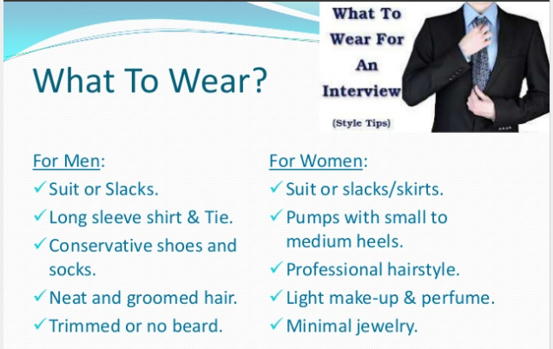
Physical Appearance
Physical appearance is important because clothing and grooming reveal something about a candidate personality and professionalism
Dress formally
The interviewee should appear in a formal dress .He should be in sober simple decent and conventional dress and polish his shoes properly.
Be well groomed.
Clothes should be clean and well pressed. a person dressed shabbily in wrinkled clothes fails to impress the lookers on. Moreover ,nails should be trimmed hair properly comes and breath fresh.
Overall the interview should appear in a pleasant image. Female candidates may wear simple and appropriate jewellery which will add to their personality.

Slide 23
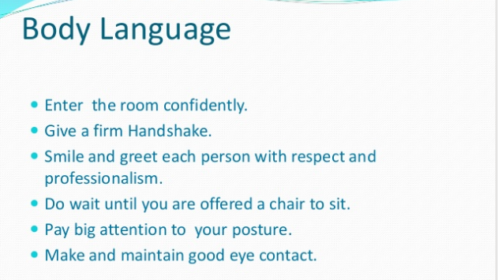

Slide 24
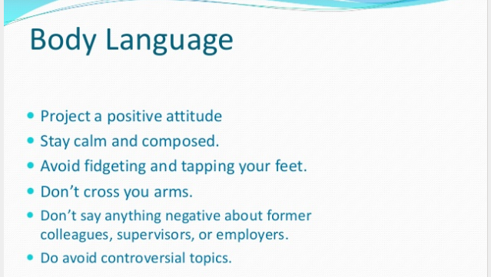

Slide 25
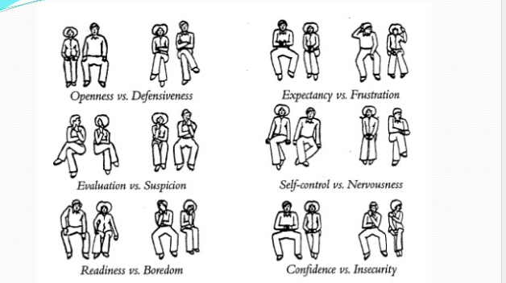

Slide 26
Be relaxed
Feeling nervous on the day of interview is natural but the interviewee should try to control his nervousness and feel relaxed. Smile at the appropriate movements and should not speak to fast to hide his nervousness.
Be prepared for an interview
Some other important points and interviewee should take notice
Take proof of your accomplishments
Reach the place of interview on time
Wait gracefully
Role of nonverbal cues
The success of the candidate to a large extent depends on his overall production it is important for the interview to cause is language as to use it effectively for communication is does the soul of success in job interview but Non verbal communication also plays a very important role.

Slide 27
Checklist: Succeeding With Job Interviews
1. Preparation:
a. Determine the requirements and general salary range of the job.
b. Research the organization’s products, structure, financial standing, and prospects for growth.
c. Determine the interviewer’s name, title, and status in the firm.
d. Prepare answers for the questions you are likely to be asked.
e. Develop relevant questions to ask.
f. Dress in a businesslike manner, regardless of the mode of dress preferred within the organization.
g. Take a briefcase or portfolio-- with pen, paper, list of questions, two resumes, work samples.
h. Double-check the location and time of the interview, mapping out the route beforehand.
i. Plan to arrive 10 to 15 minutes early; allow 10 to 15 minutes for possible problems on route.

Slide 28
2. Initial Stages of the Interview:
a. Greet the interviewer by name, with a smile and direct eye contact.
b. Offer a firm handshake if the interviewer extends a hand.
c. Take a seat only after the interviewer invites you to be seated or has taken his or her own seat.
d. Listen for cues about what the questions are trying to reveal about you and your qualification.
e. Assume a calm and poised attitude (avoiding gum chewing, smoking, and other signs of nervousness)
3. Body of the Interview:
a. Display a genuine (not artificial) smile.
b. Convey interest and enthusiasm
c. Listen attentively so that you can give intelligent responses
d. Relate your knowledge and skills to the position and stress your positive qualities
e. Keep responses brief, clear, and to the point
f. Avoid exaggeration, and convey honesty and sincerity
g. Avoid slighting references to former employers
h. Avoid alcoholic drinks if you are interviewed over lunch or dinner.

Slide 29
4. Salary Discussion:
a. Let the interviewer initiate the discussion of salary, but put it off until late in the interview if possible.
b. If asked, state that you would like to receive the standard salary for the position.
5. Closing Stages of the Interview:
a. Watch for signs that the interview is about to end.
b. Tactfully ask, when you will be advised of the decision on your application.
c. If you’re offered the job, either accept or ask for time to consider the offer.
d. With a warm smile and a handshake, thank the interviewer for meeting with you.
Interviewer’s Preparation(Conducting Interview)
Interviewer is a person who puts questions to the interviewee. An interviewer plays an important role in interviewing because he can choose good and potential candidate and at the same time reject the undeserving candidates.

Slide 30
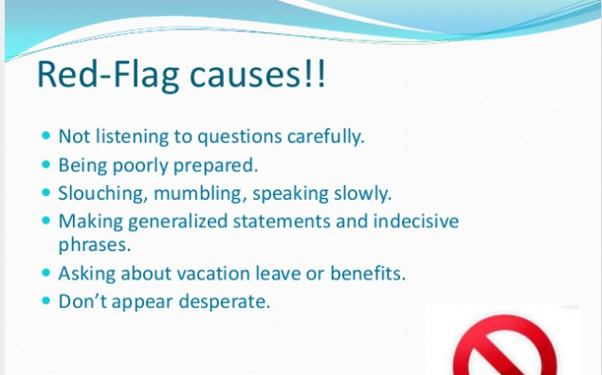

Slide 31
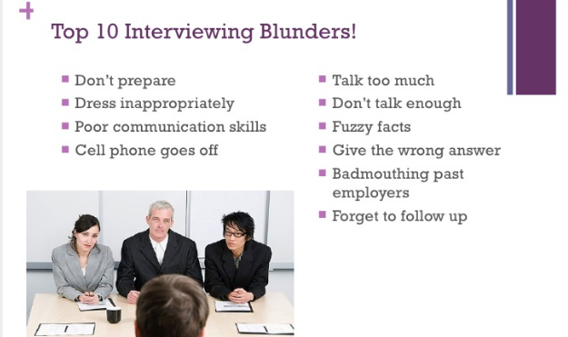

Slide 32
Guidelines for Conducting an Interview:
An interviewer must be a man of integrity, honesty, confidence and of logical thinking. Below are listed certain guidelines which if followed may lead to significant results.
a. The interviewer should have a detailed job description for which he/she is going to interview the candidates. He/she should have the details of the title of the post, duties and responsibilities related to the post, working conditions, stress conditions, salary, allowances, bonus and other benefits.
b. To study carefully the resumes of the candidates who have applied for a job to judge if the applicant’s attainment match to the requirements for the job.
c. Prepare a list of the questions he/she would like to ask to judge the level of skill attained by the applicant.
d. An interviewer should be a good communicator and be a patient listener.
e. No irrelevant questions should be asked. Also one question should be asked at a time.
f. Interview should be conducted in adequate setting. For this a place free from noise, telephone calls visitors and interruptions should be selected.

Slide 33
Steps in Planning an Interview:
a. Establishing (ensure) purpose or purposes to be achieved.
b. Collecting preliminary information on the subject and/or the interviewee.
c. Determining the amount of structure to impose.
d. Identifying and perhaps, recording the strategic questions or responses that seem to posses potential for fulfilling the interview purpose.
e. Determining the time, place and length of time for the interview.
f. Communicating the purpose, place, time, and length of time to the interviewee.
g. Personal preparation e.g. knowing where one stands on crucial issues and attitudes and predicting points of conflict and resistance.

Slide 34
THANKS

